Slide 1

BCTS-PIB Wildfire Risk Reduction
Ian Petersen, RPF, Land and Resource Coordinator - BCTS

Slide 2

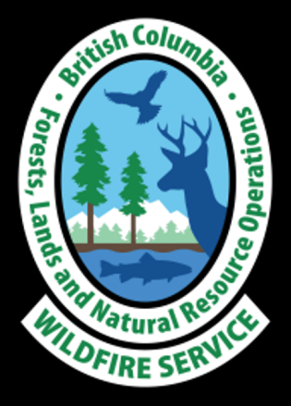
Primary Funding
Community Resiliency Investment Program (CRI)
Crown Land Wildfire Risk Reduction
(CLWRR)
Firesmart BC

Slide 3
Primary Funding
Community Resiliency Investment Program (CRI)
Crown Land Wildfire Risk Reduction
(CLWRR)
Firesmart BC
Notes:
Government of BC has committed funding over the next few years to create defendable zones for wildfire fighters to more effectively fight wildfires in the urban interface.

Slide 4


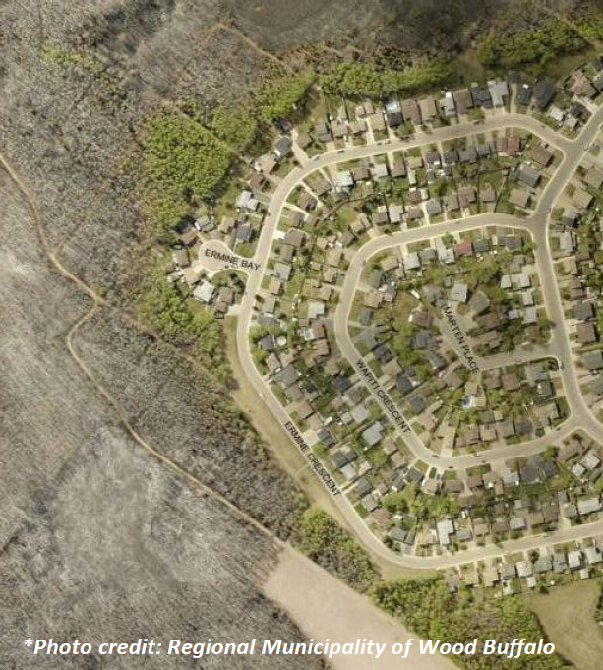

Fuel Mitigation Overview
Landscape level wildfire risk reduction within the Wildland Urban Interface (WUI)
Protecting Human life, communities, and critical infrastructure
Create defendable zones for First Responders
Ecosystem restoration/resiliency

Slide 5
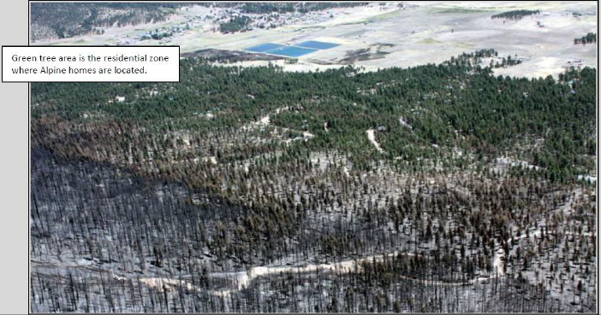
Fuel Mitigation Overview
Primary objective: Reduce the potential fire behaviour over an area to facilitate successful and safe suppression efforts.
Generally achieved by:
  reducing the amount of fuel loading (targeting fine woody debris ‘flashy fuels’) on the forest floor,
  reducing ladder fuels (increasing crown base height),
  reducing the crown closure and canopy bulk density (where ecologically appropriate).

Slide 6
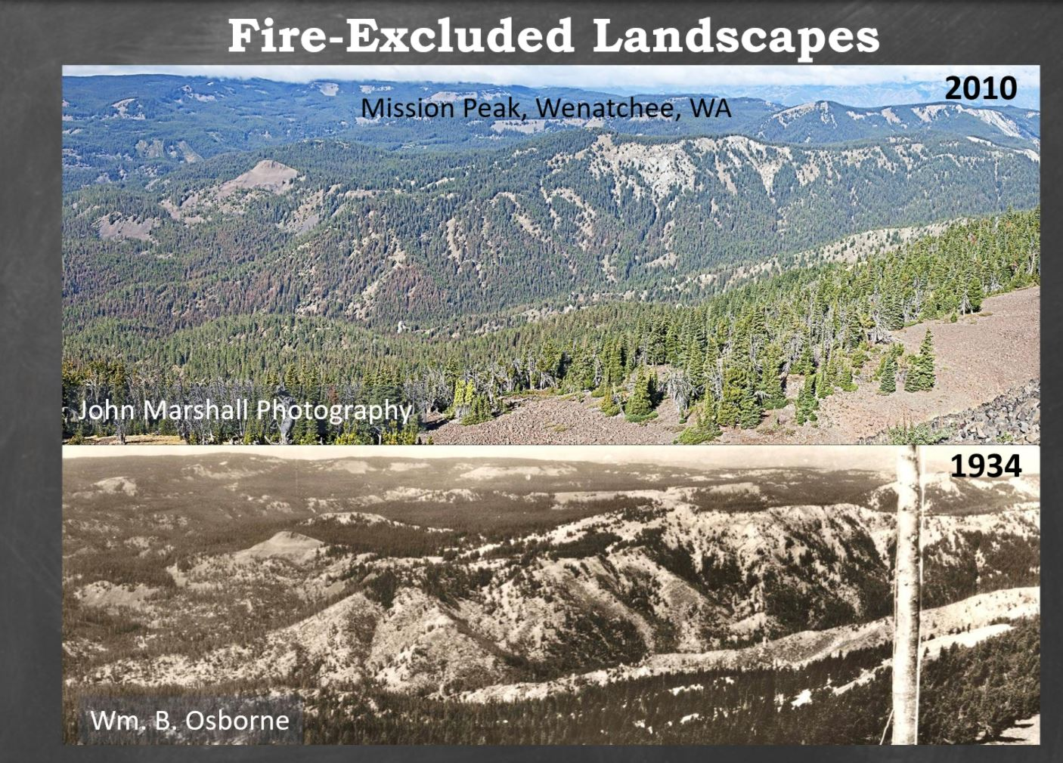
Notes:
Fire exclusion leads to unhealthy and unnaturally dense forests in ecosystems that depend on frequent stand maintaining wildfires. Frequent stand maintaining wildfires help forests be more resilient towards drought stress, disease outbreaks, and wildfire intensity. This exclusion also allows for the build up of fuels to unprecedented levels so that when the forest does eventually burn (not a question of will) it burns very hot. This has many negative effects, including scorching and creating hydrophobic soils which can lead to flash floods and erosion. It can deplete the viable seedbed of conifers so that it takes a very long time before they establish again.

Slide 7
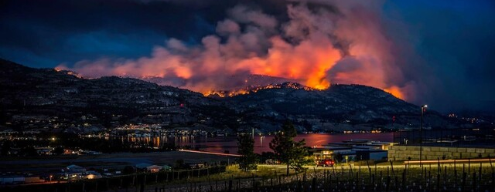
Mt. Christie Wildfire (K51287)
z
Castanet.net
Notes:
A current reminder of the importance of these projects. With climate change projections, it is clear that we need to adapt to increased wildfire frequency and intensity. Fuel treatments are tool for us to use to prepare our communities for surviving these changes.

Slide 8
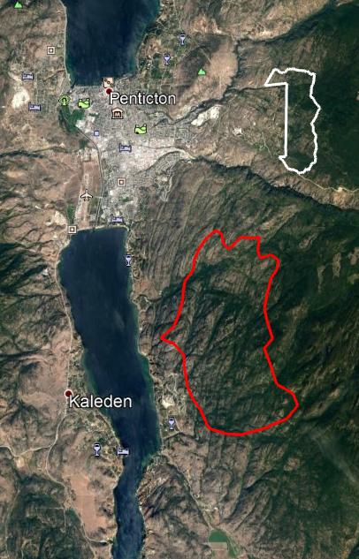
Christie Mountain Wildfire and
Fuel Management Area
z

Slide 9
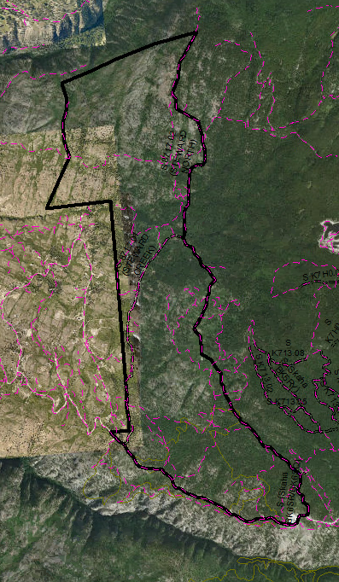

Slide 10
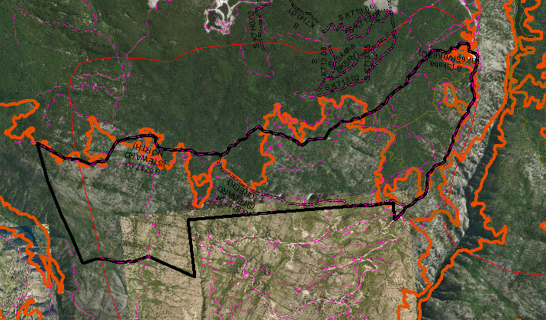
Notes:
Outlined in Orange is the Carmi mountain wildfire of 1994 (~5000 ha – human caused). The thin red outline is another wildfire from 1926 (~4000ha – lightning). The 94 burn has left us with a network of patches with a range of fuel loading. We would like to reduce the high fuel loading in areas to connect to areas of low fuel loading in order to work with nature and maximize the fuel mitigated area and provide the best defendable zone we can. Zoom to pictures for examples of fuel loading in the area.

Slide 11
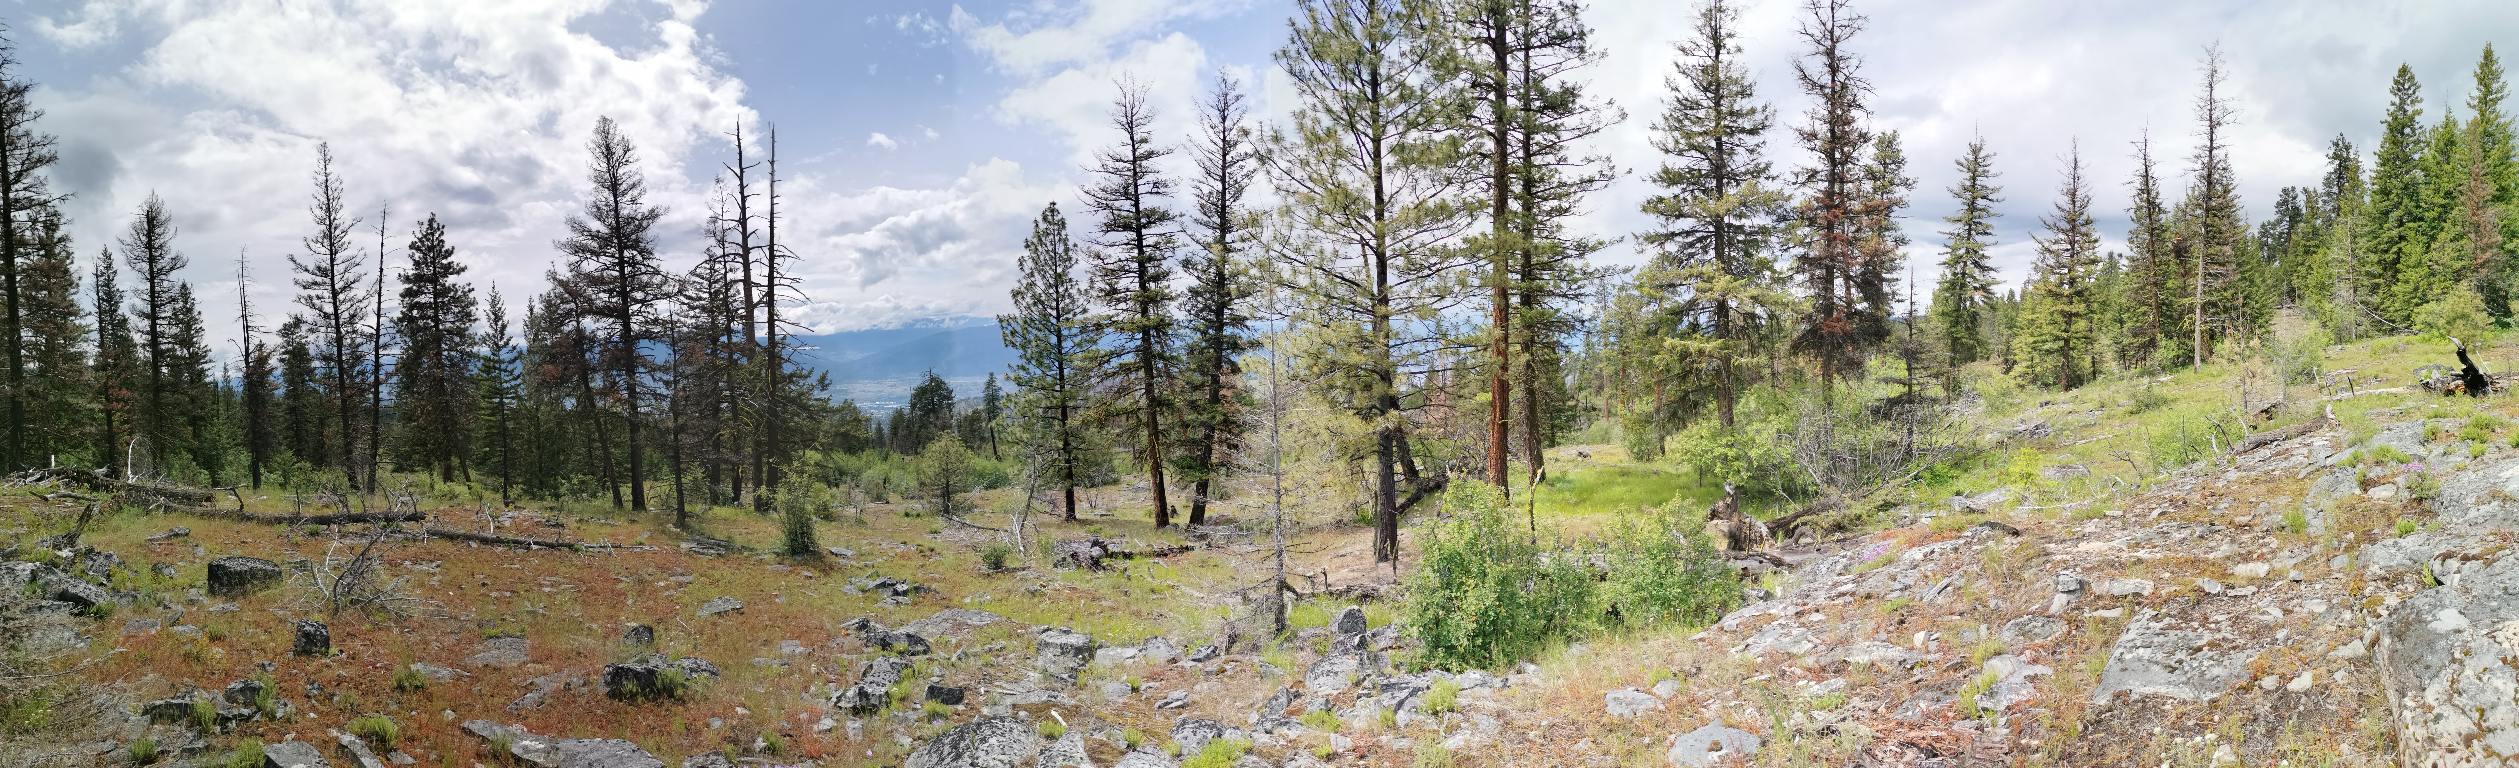
Ian P.

Slide 12
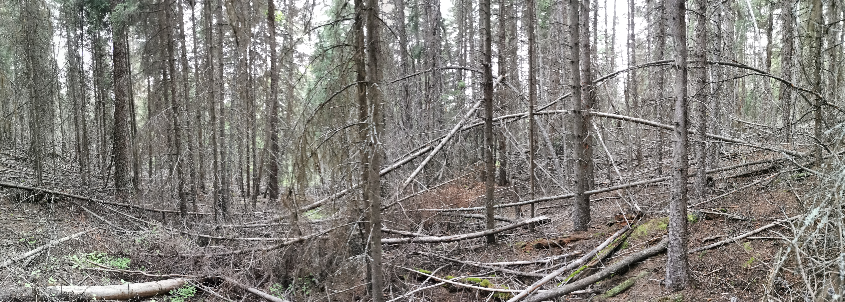
Ian P.

Slide 13
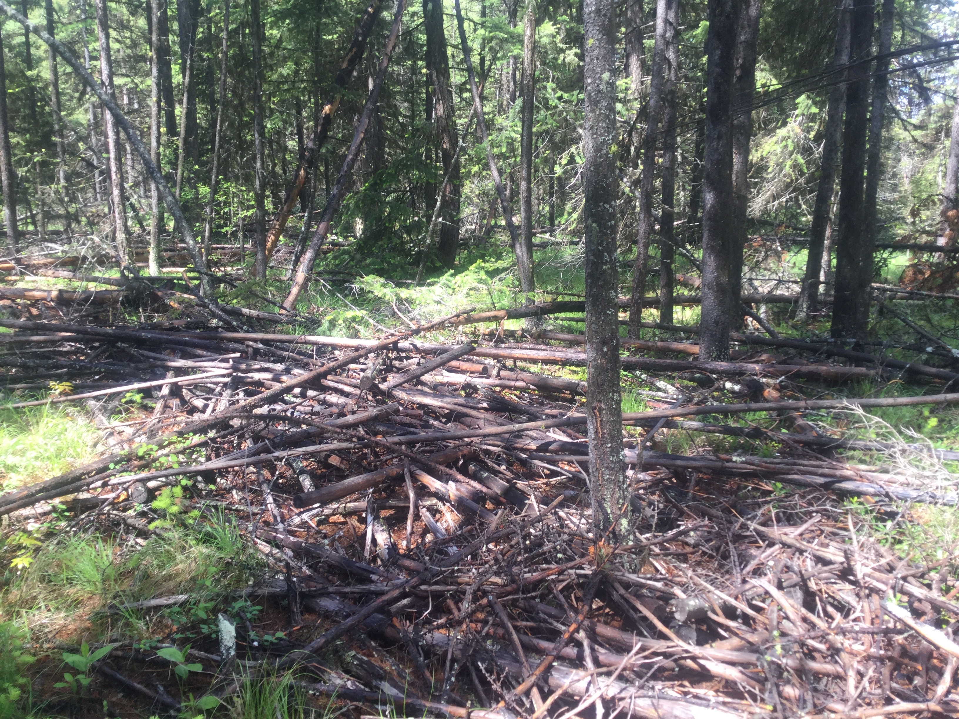
Ian P.

Slide 14
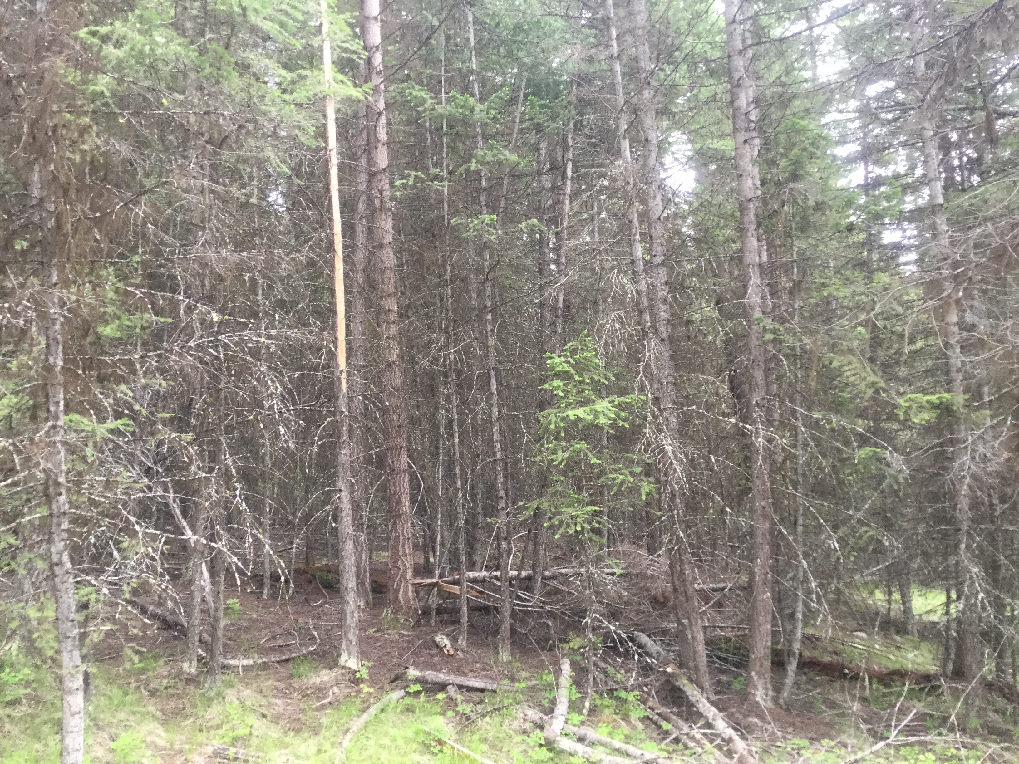
Ian P.

Slide 15
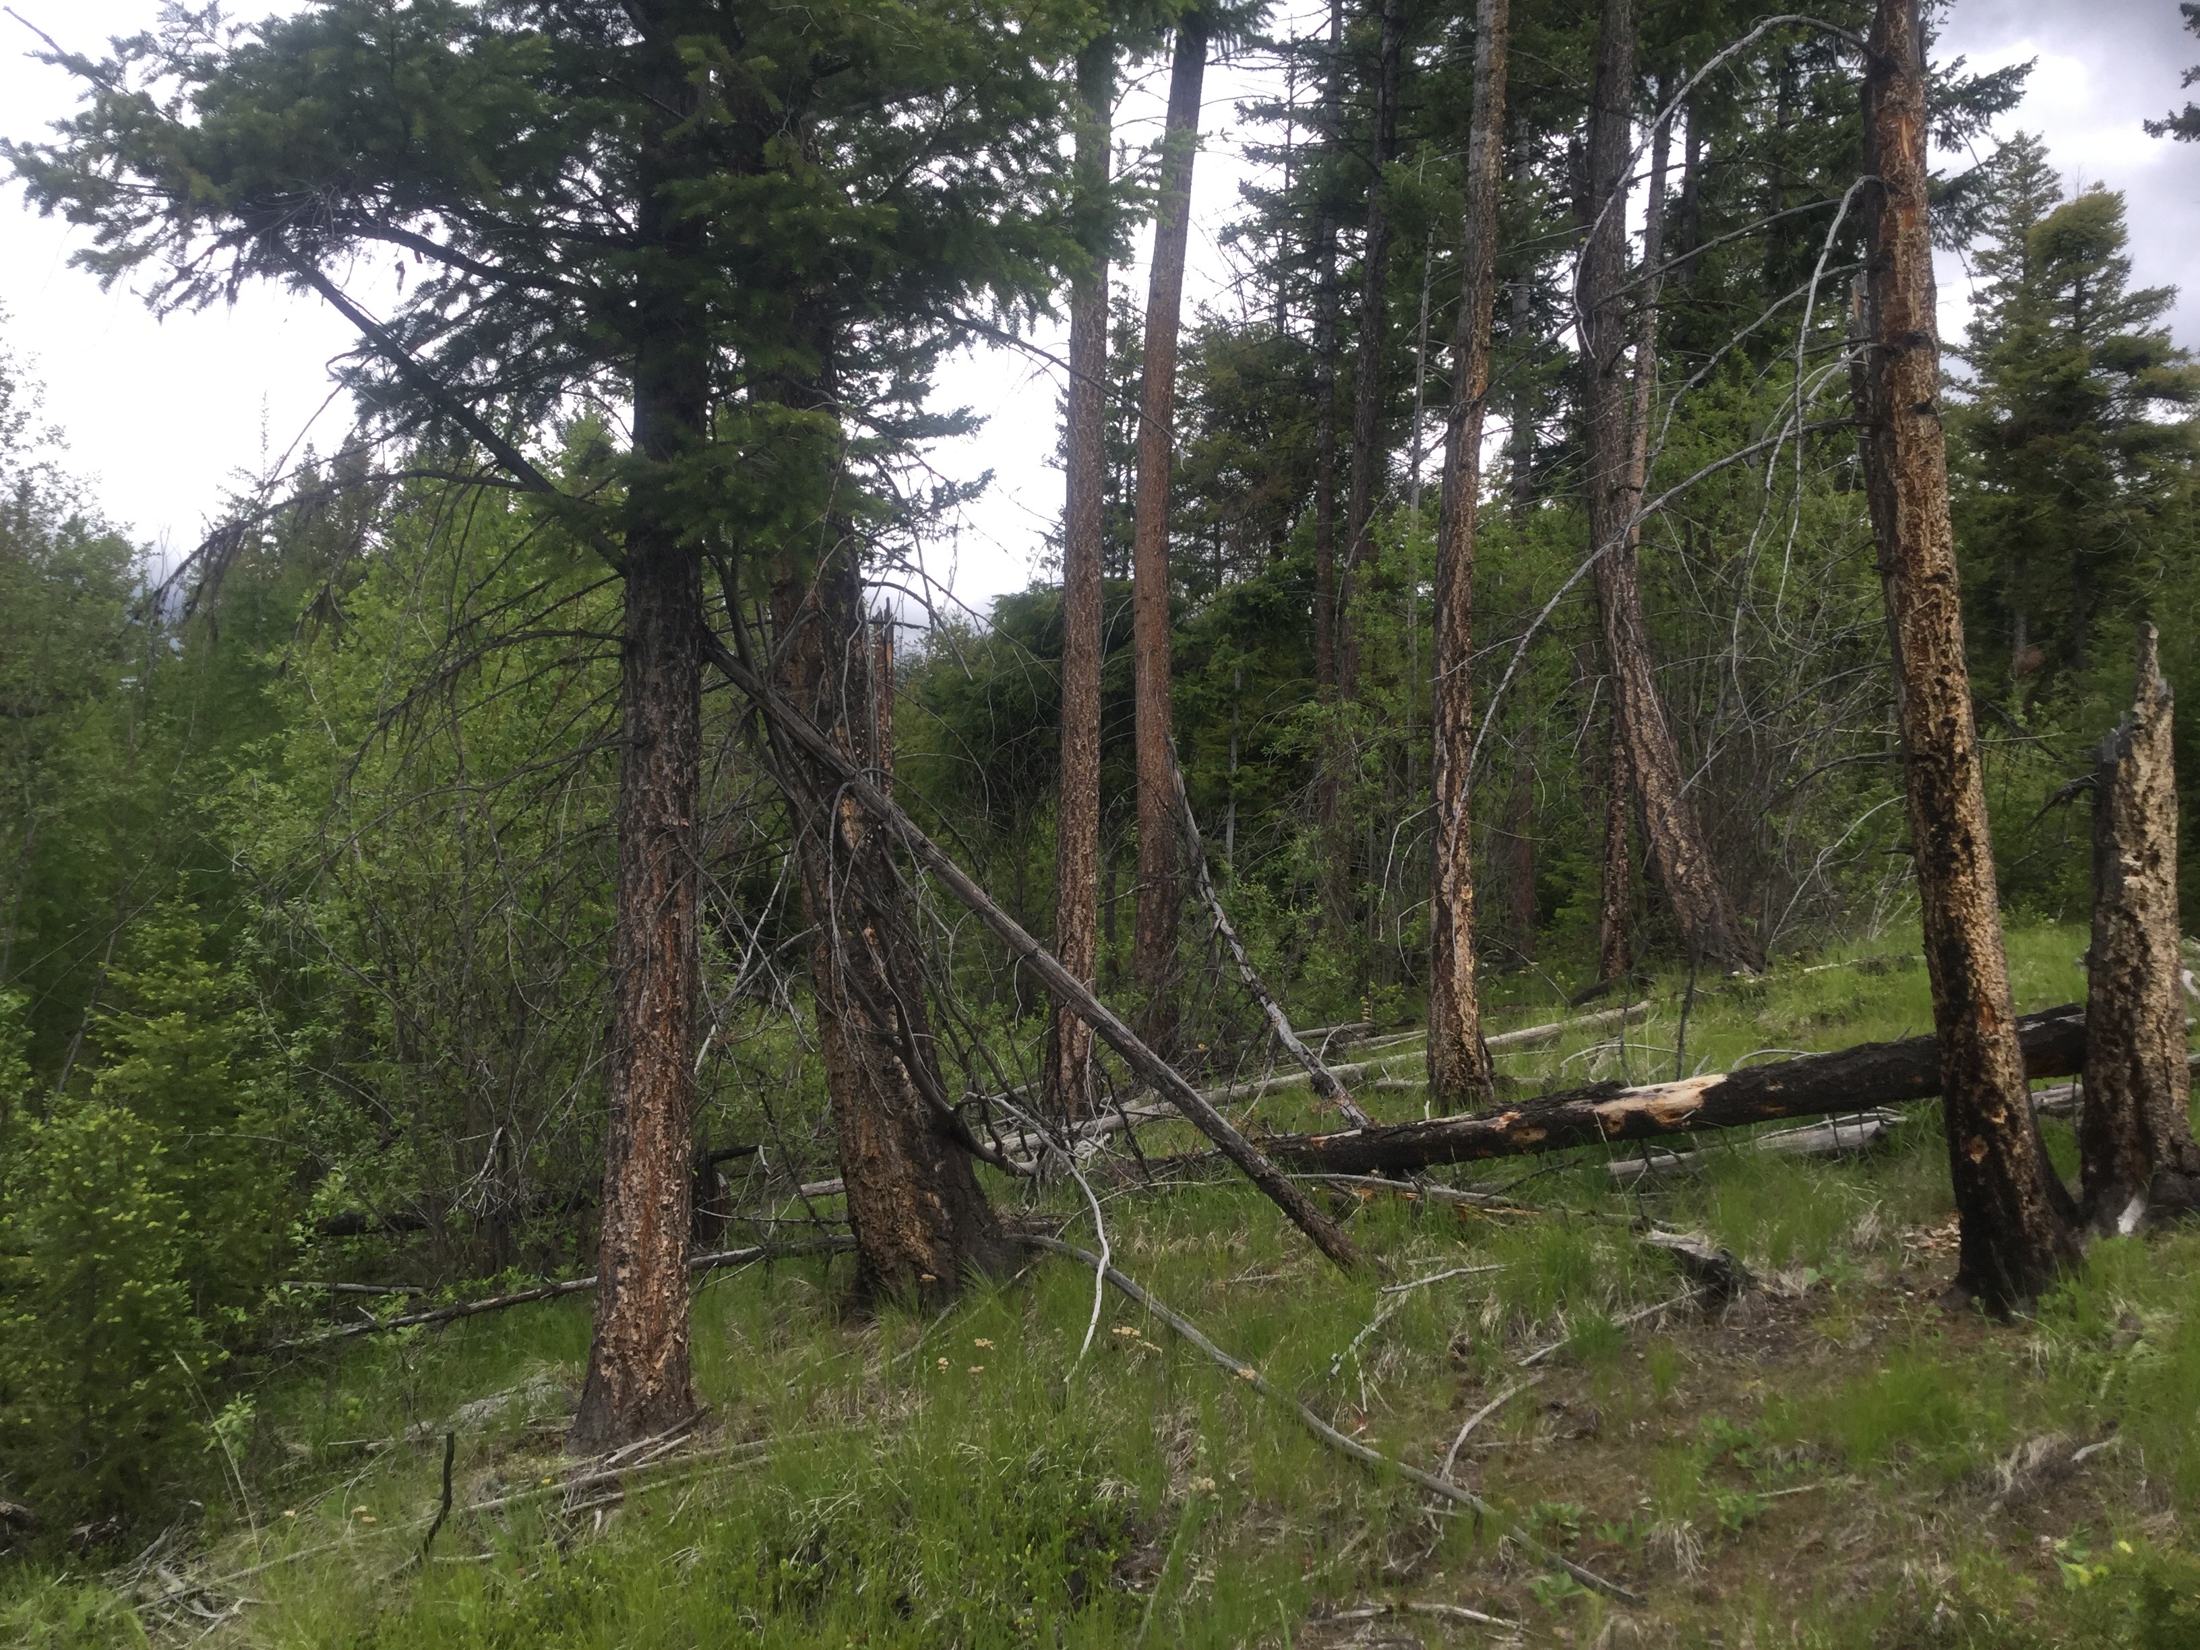
Ian P.

Slide 16
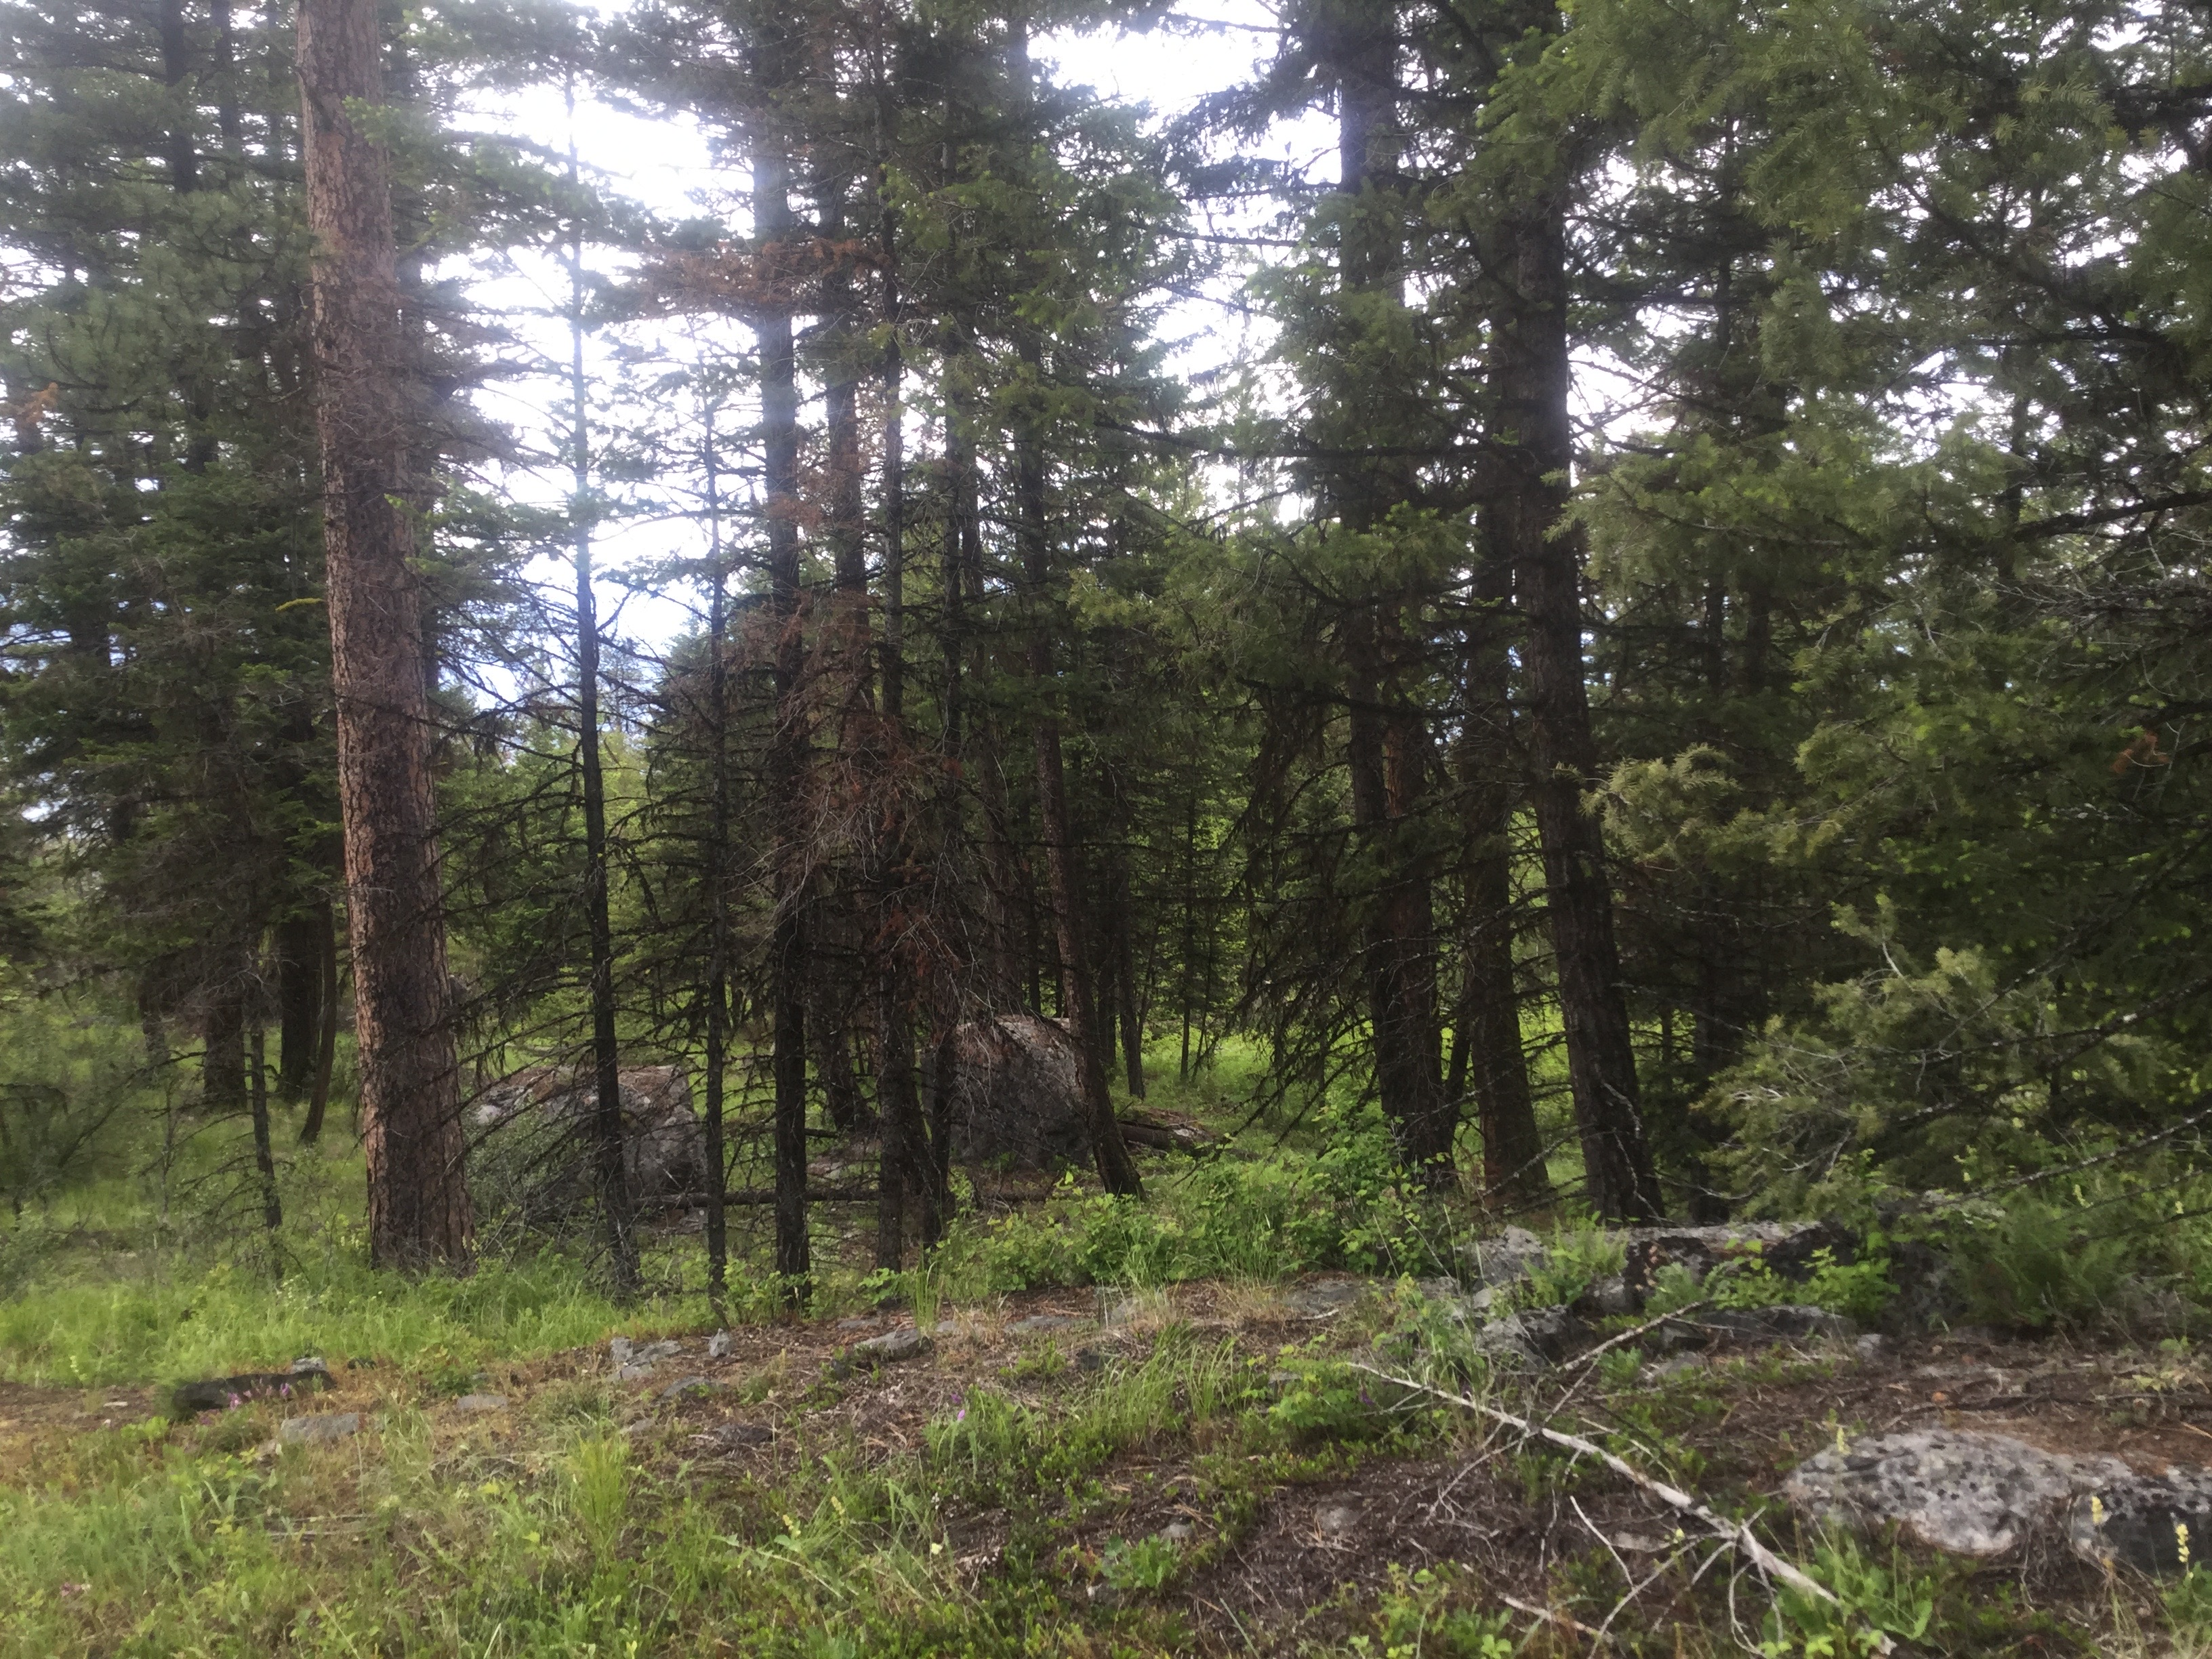
Ian P.

Slide 17
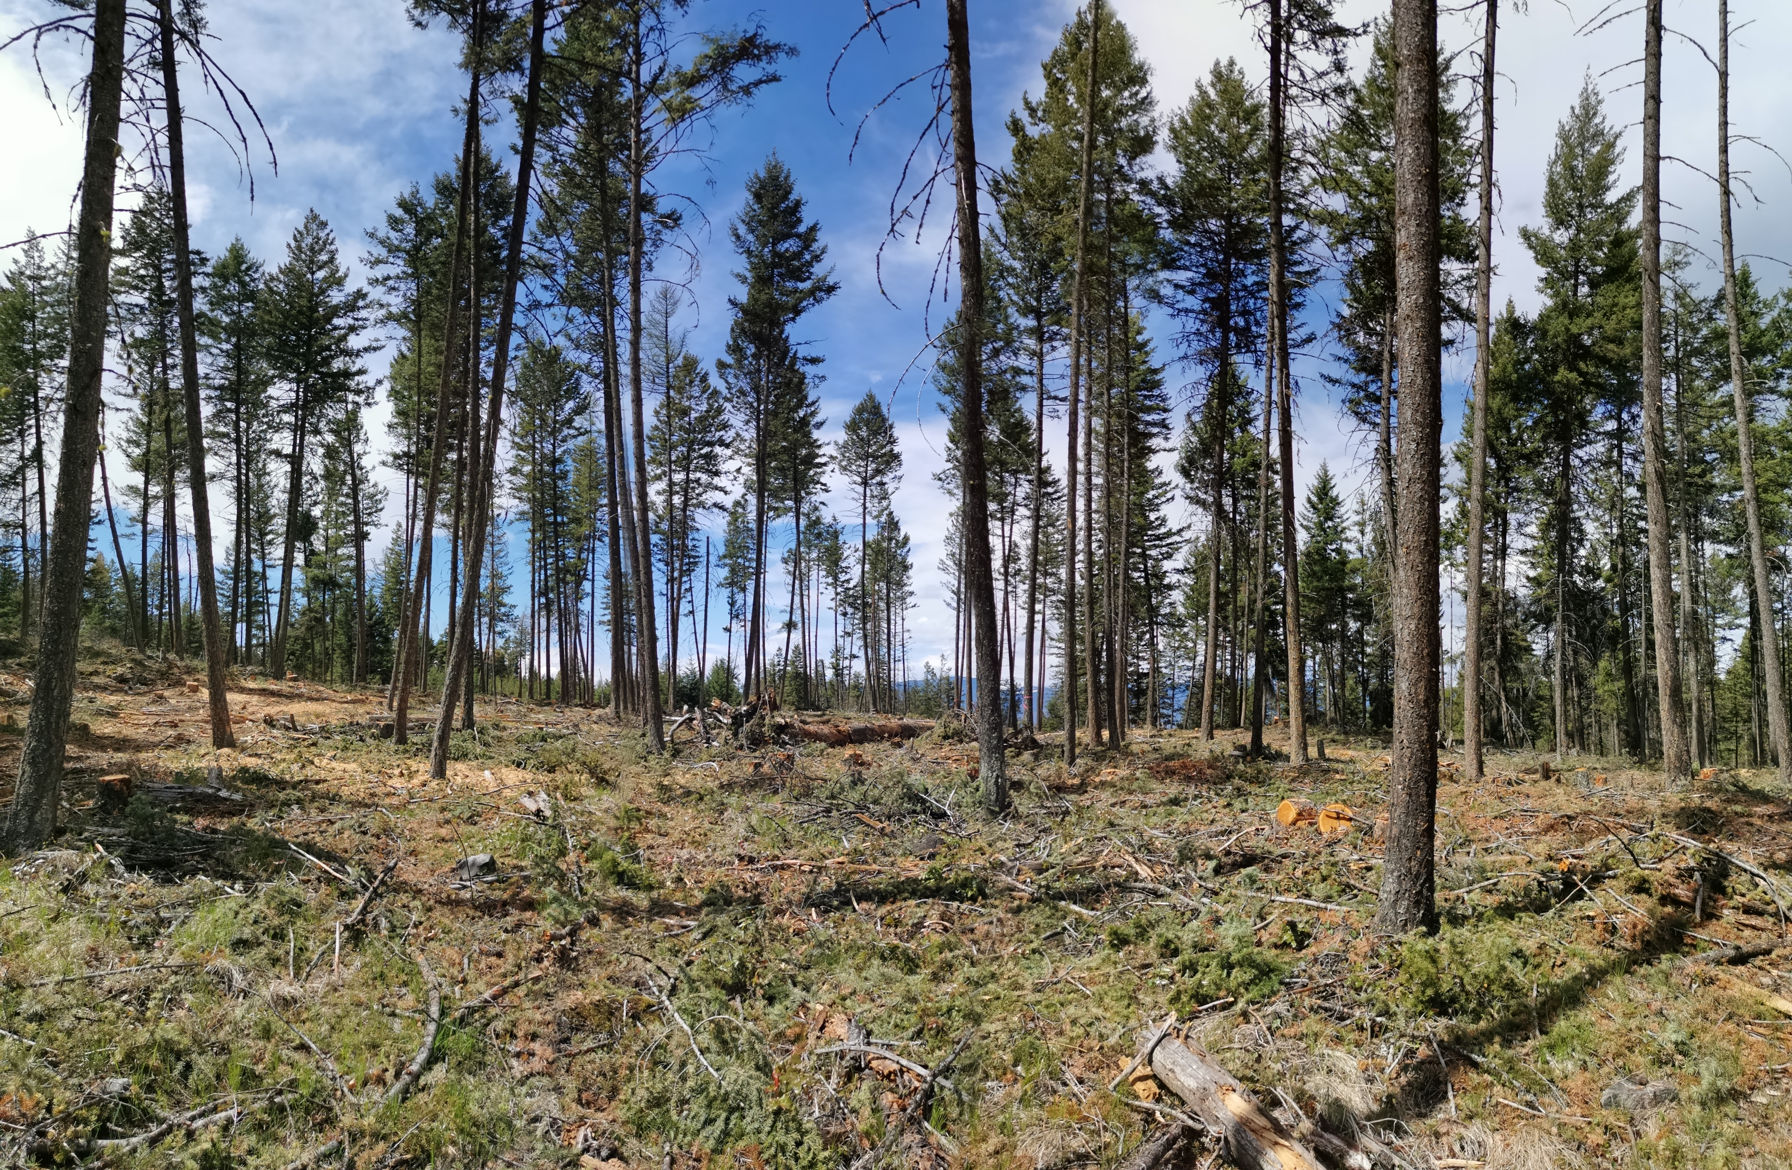
Myra Bellevue Fuel reduction and ecosystem restoration treatment, Ian P.
Notes:
Example of canopy thinning, ladder fuel and ground fuel reduction in Myra Bellevue Provincial Park. A retention strategy will be determined for the mechanical treatment areas that will likely create patches of retention area.

Slide 18
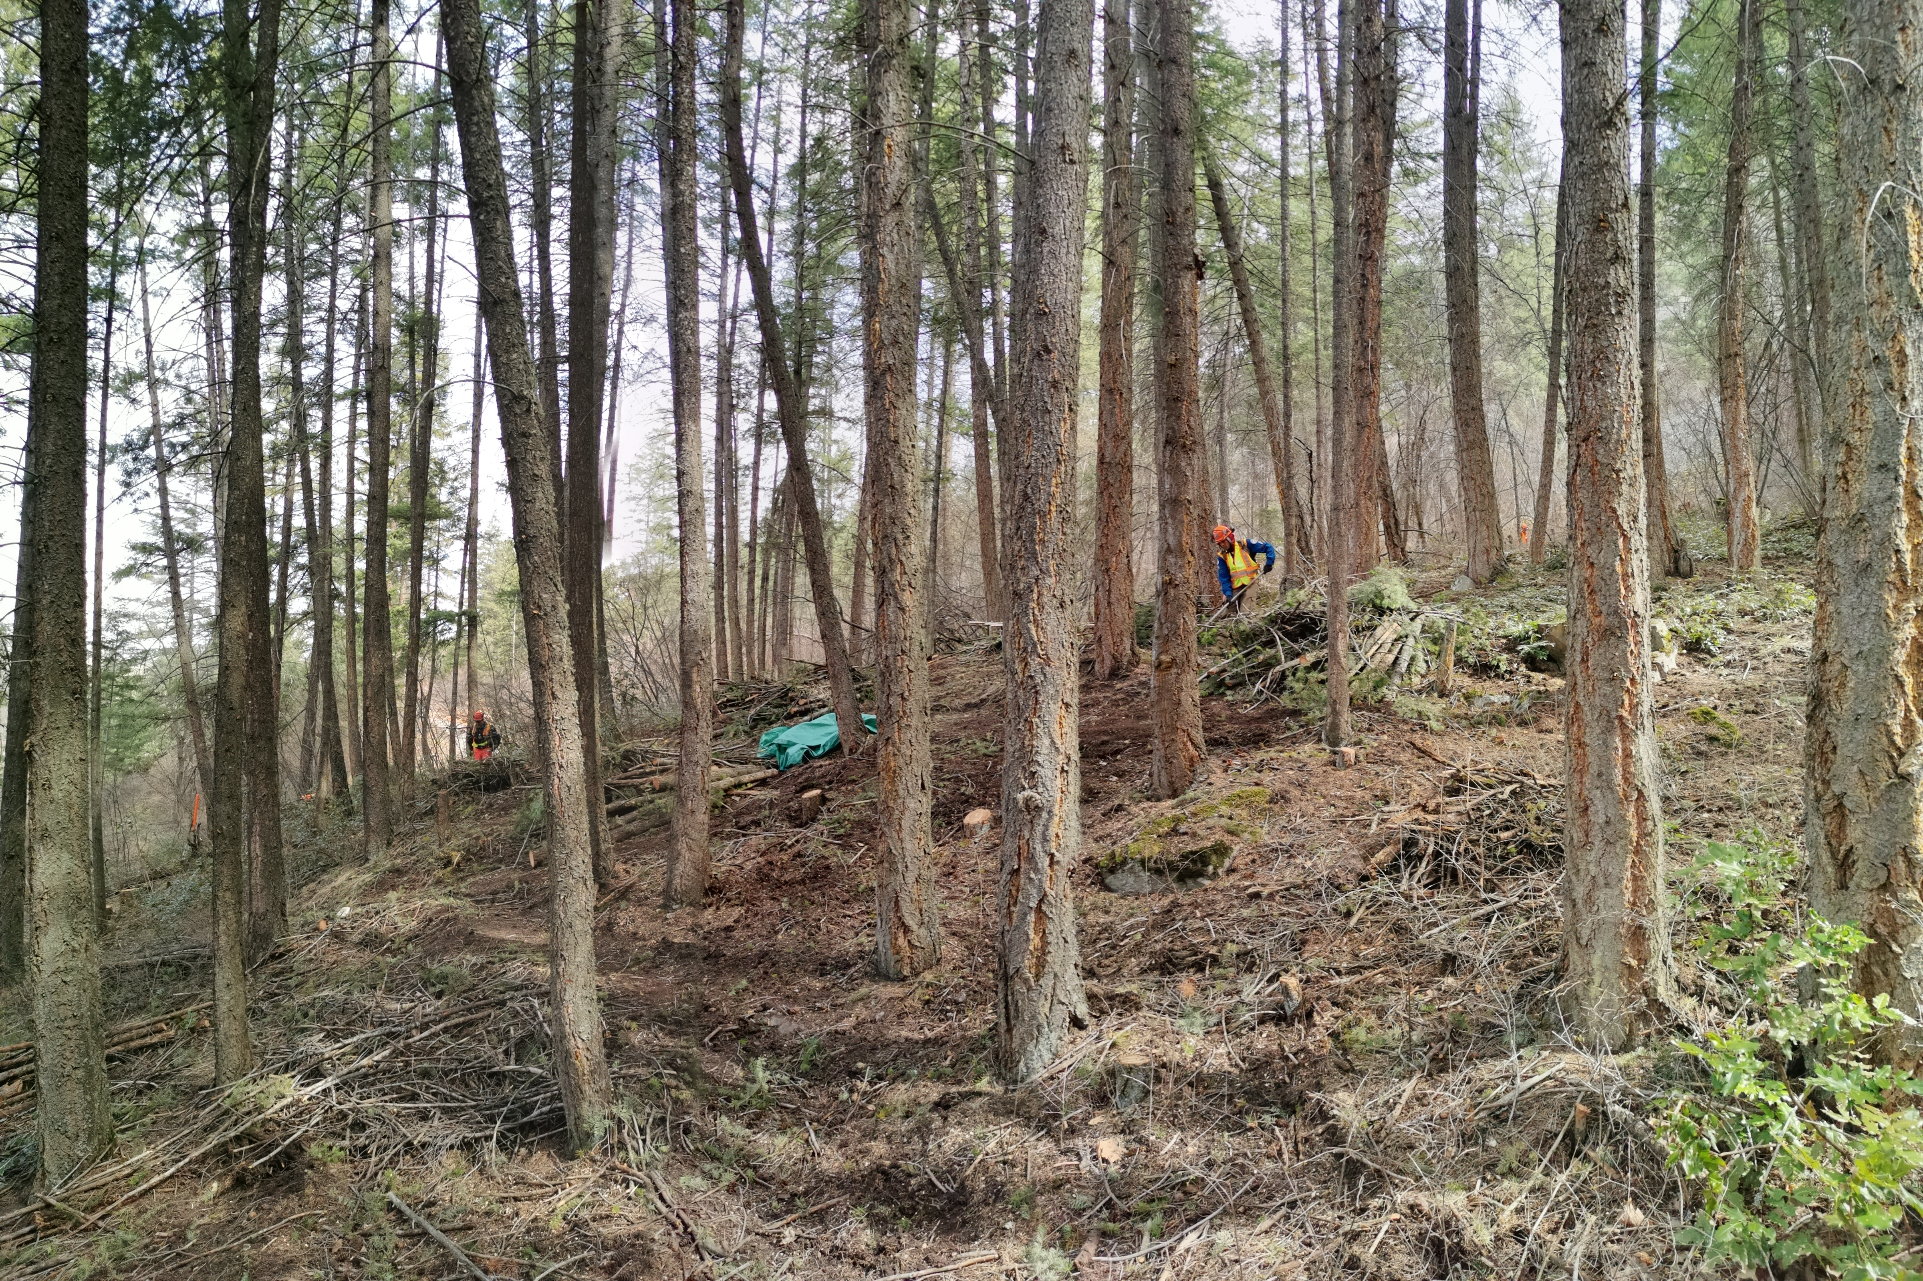
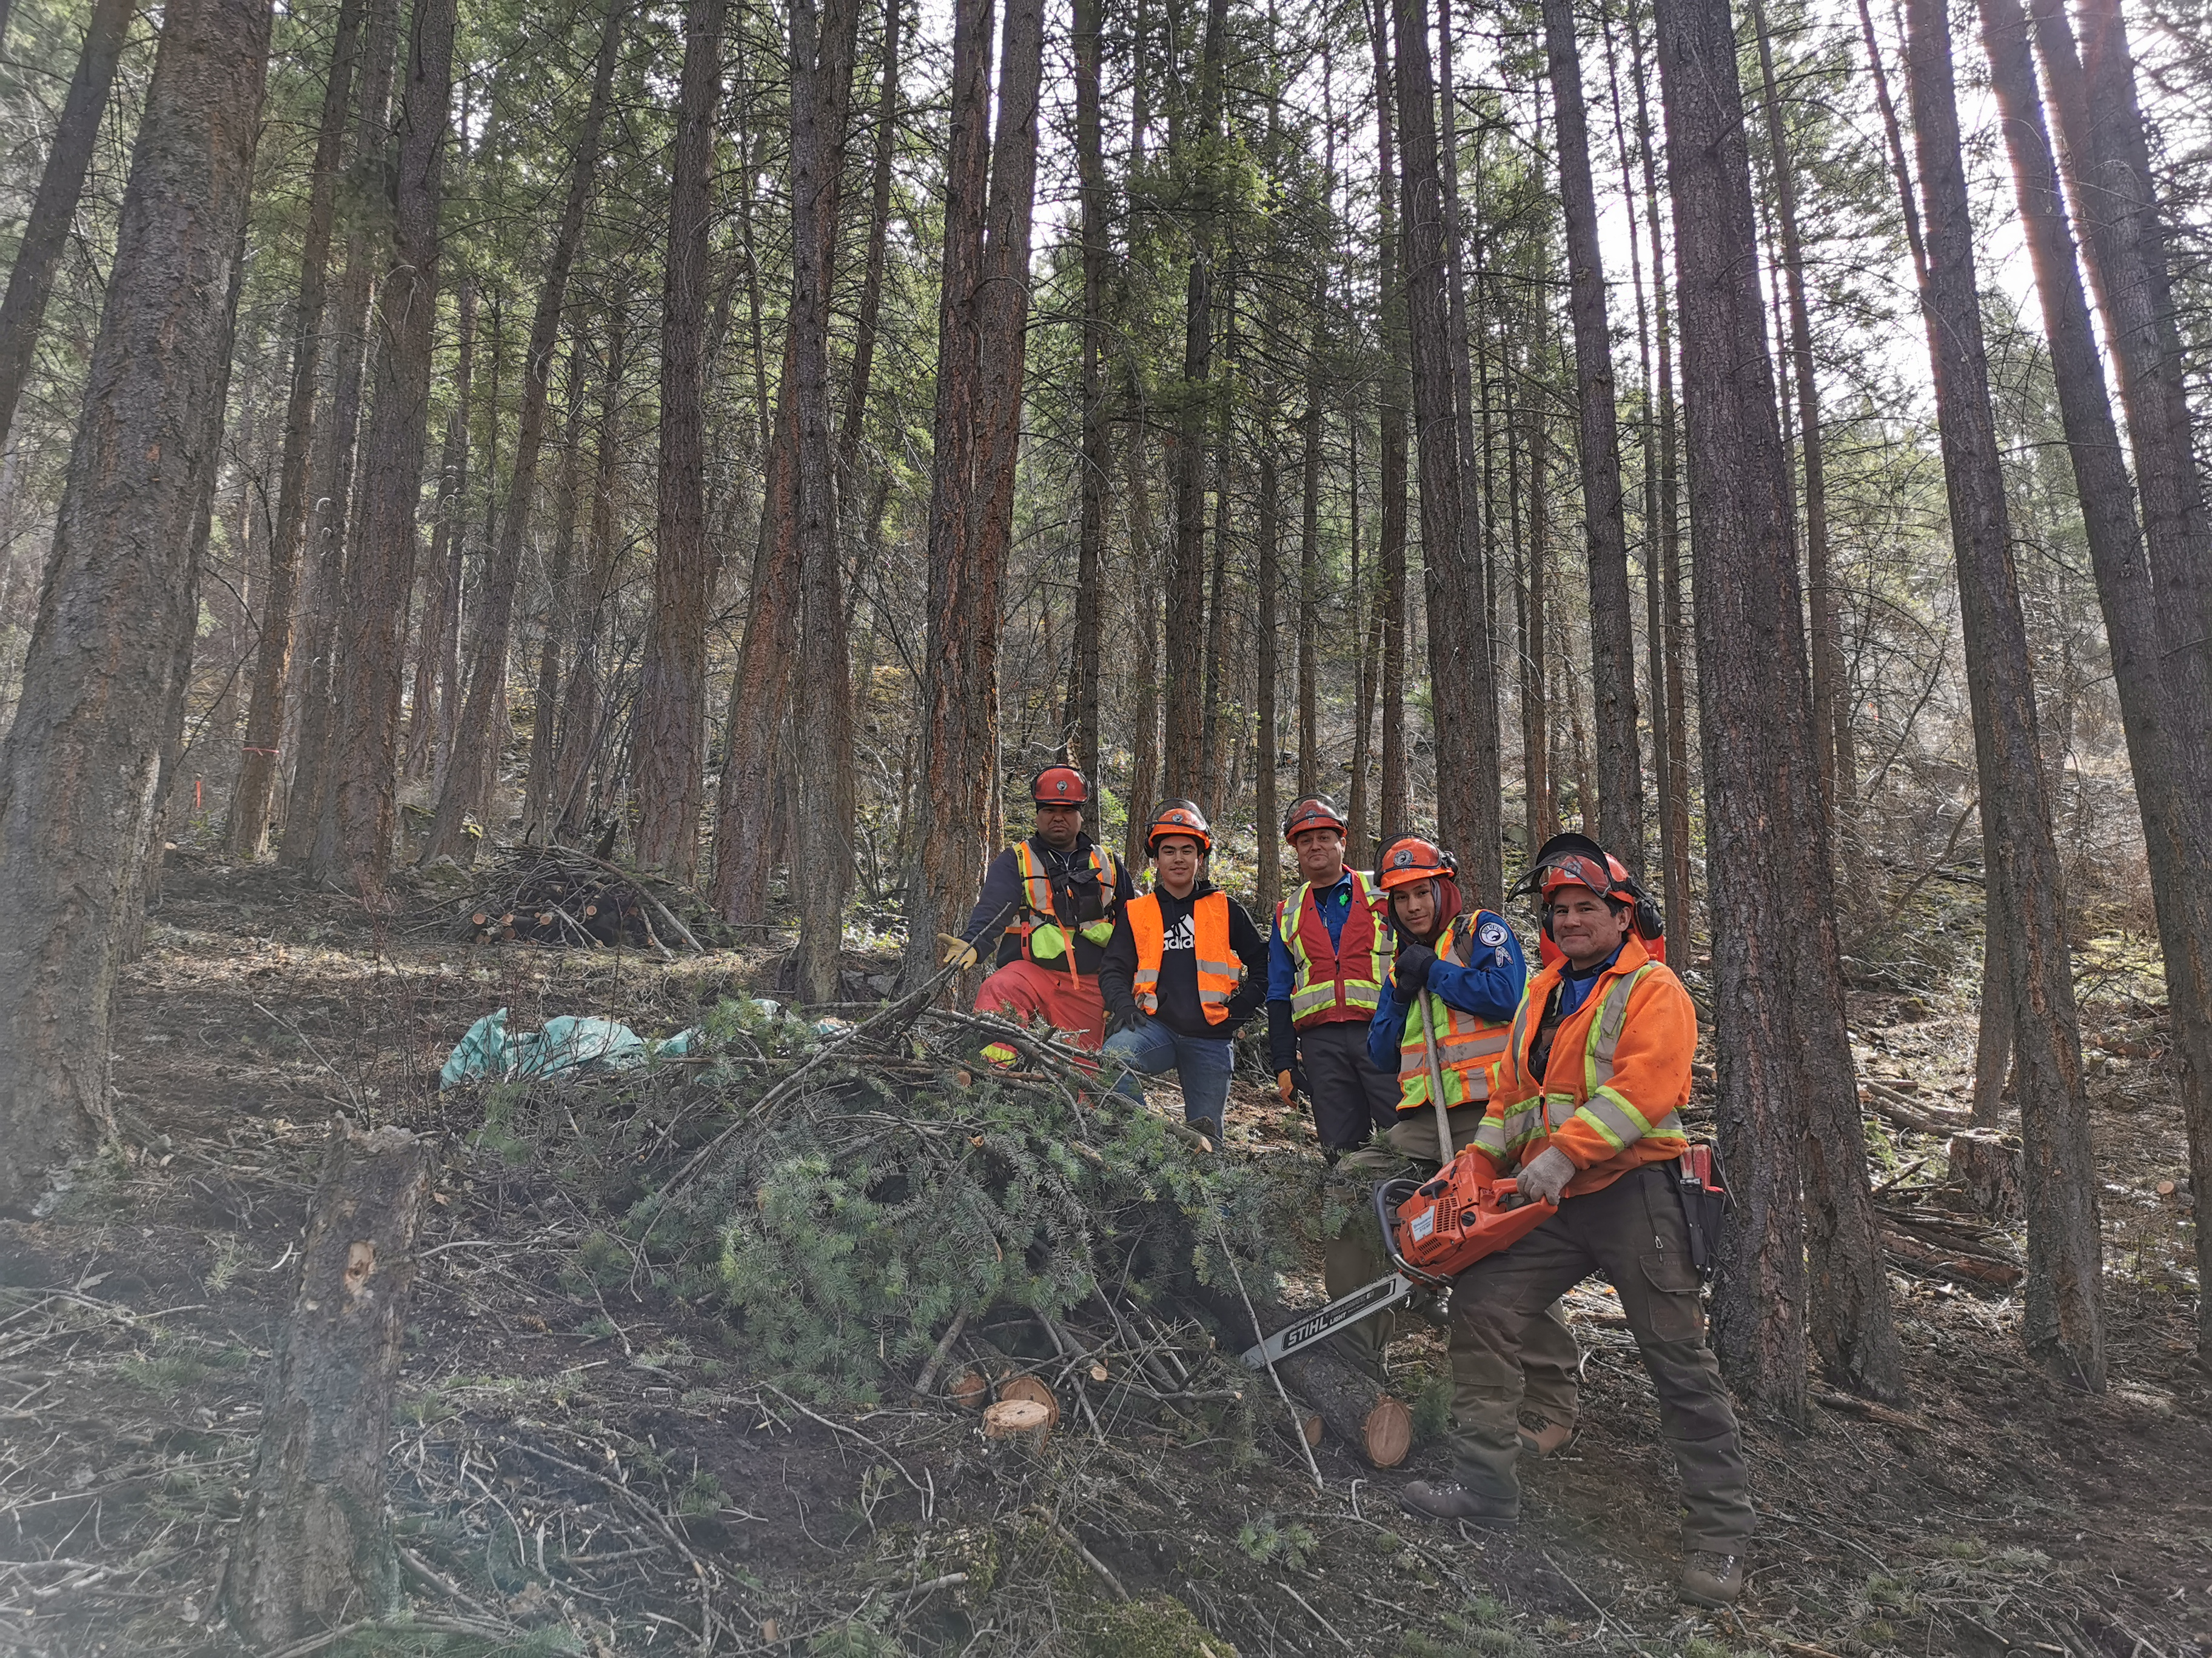
Rider Ventures Ltd and OKIB members completing hand treatment, Ian P.
Notes:
Example of ladder and ground fuel reduction without canopy thinning. Our hand treatments will likely utilize a combination of canopy thinning and canopy retention depending on the ecology of the site and the current canopy density.

Slide 19
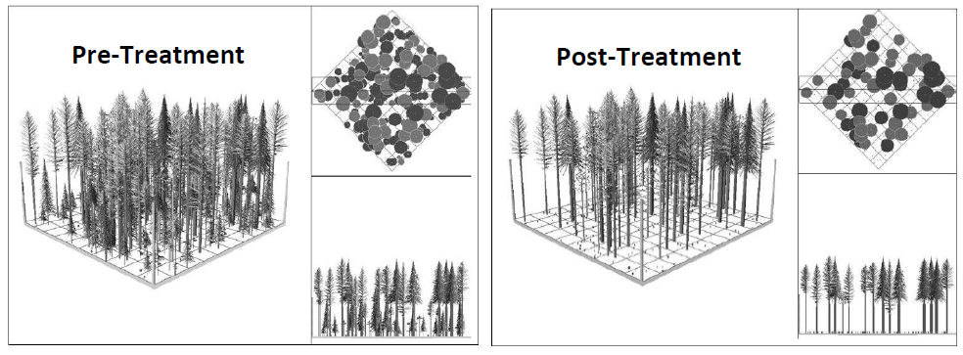
Potential Hand Treatment Visualization
(Treatment visualization adapted from Peterson et al. 2005)
Notes:
Just to further illustrate what portions of the hand treatment may look like. We would like to achieve a shaded fuel break, focusing on a uniform thin from below strategy, removing a small portion of the canopy.
The mechanical treatments will focus more on patch retention clumps, where the patches will likely retain all of the mature trees, but may require some removal of ground and ladder fuels.

Slide 20
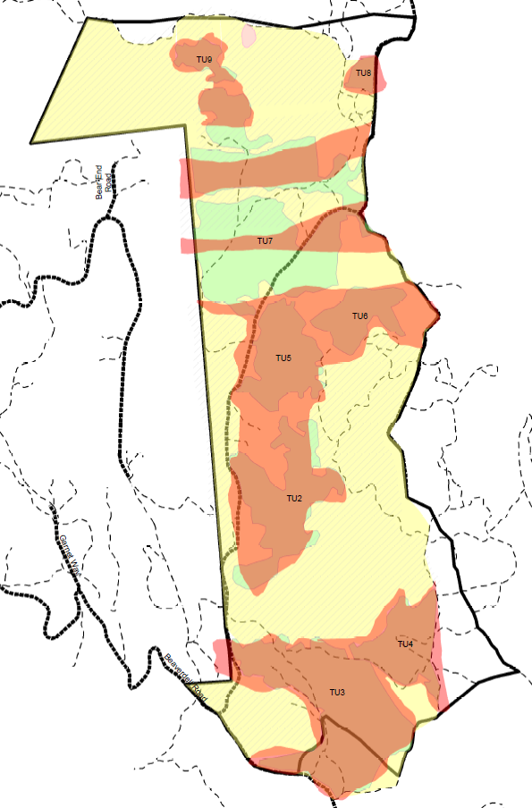
Fuel Modification Treatment
Hand Treatments
Slashing
Thinning
Pile & Burn
Remove
Mechanized Treatments
Thinning
Non-Merch
Fibre Recovery
Prescribed Burning
Pellets / Chips
Notes:
Here is our project area. It will consist of a continuous fuel break that will be established by hand treatments. Mechanical treatments will be contiguous to the hand treatment. We are currently prioritizing the areas that most require hand and or mechanical treatments while balancing numerous values for First Nations Cultural/traditional use, Ungulate winter range, Visual quality, species and ecosystems at risk, riparian features, and more. Mechanical treatments tied to the hand treatments will allow for an economical way to improve our fuel modification treatment.
The hand treatments will occur from the private property outwards, connecting the red areas where mechanical treatment may take place. The hand treatment will anchor to areas that are at lower risk of producing an intense wildfire by tying into a large burned area to the north, and to the Beaver Dell FSR, the canyon, and previously completed fuel treatments in the South.

Slide 21
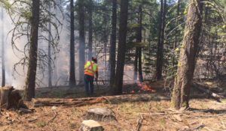
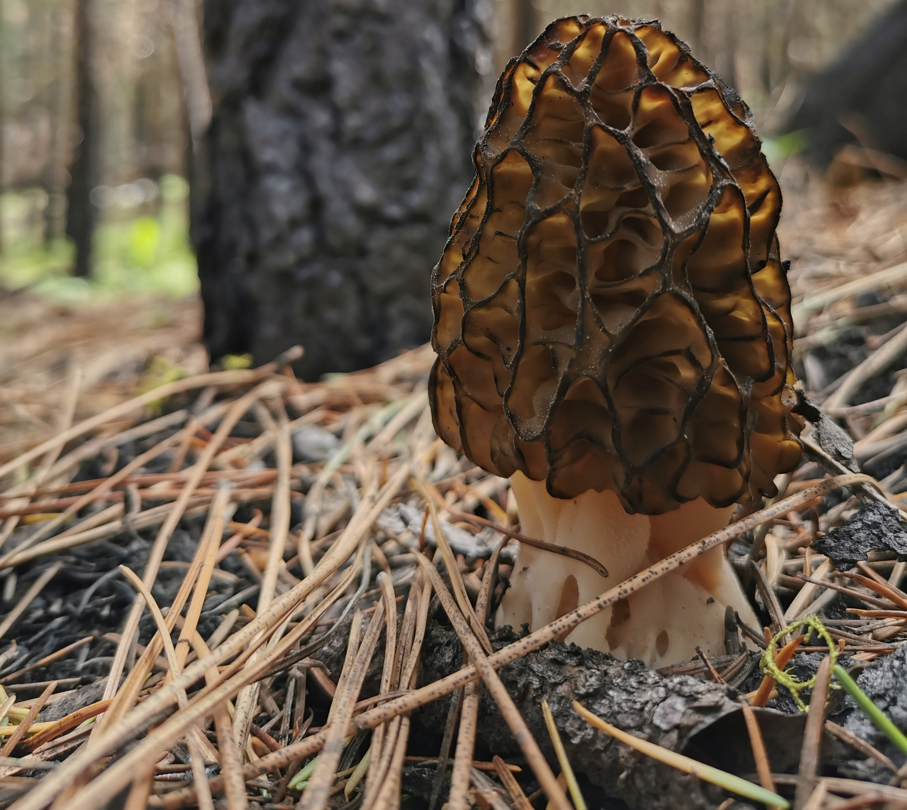
Prescribed burning
Typically used as a maintenance treatment (>5yrs)
Important traditional practice to many First Nations
Potential for added economic/foraging opportunities through morel harvesting
Aids in maintaining ecosystem health, especially in these ecosystems that should experience frequent stand maintaining wildfires
ONA, Syilx prescribed burning (https://www.syilx.org/projects/prescribed-burns/)
Morel, Ian P.

Slide 22
Summary of Stages
2020-2021
Planning with PIB
Prescription Development
Hand Treatment
Hand Treatment
(Biomass removal – pile burning
Biomass Removal
Spring
Summer
Fall
Winter
Spring
Mechanical Treatment Development
Referral
Mechanical Treatment
Biomass Removal or pile burning
Abatement confirmation
2021-2022/23

Slide 23
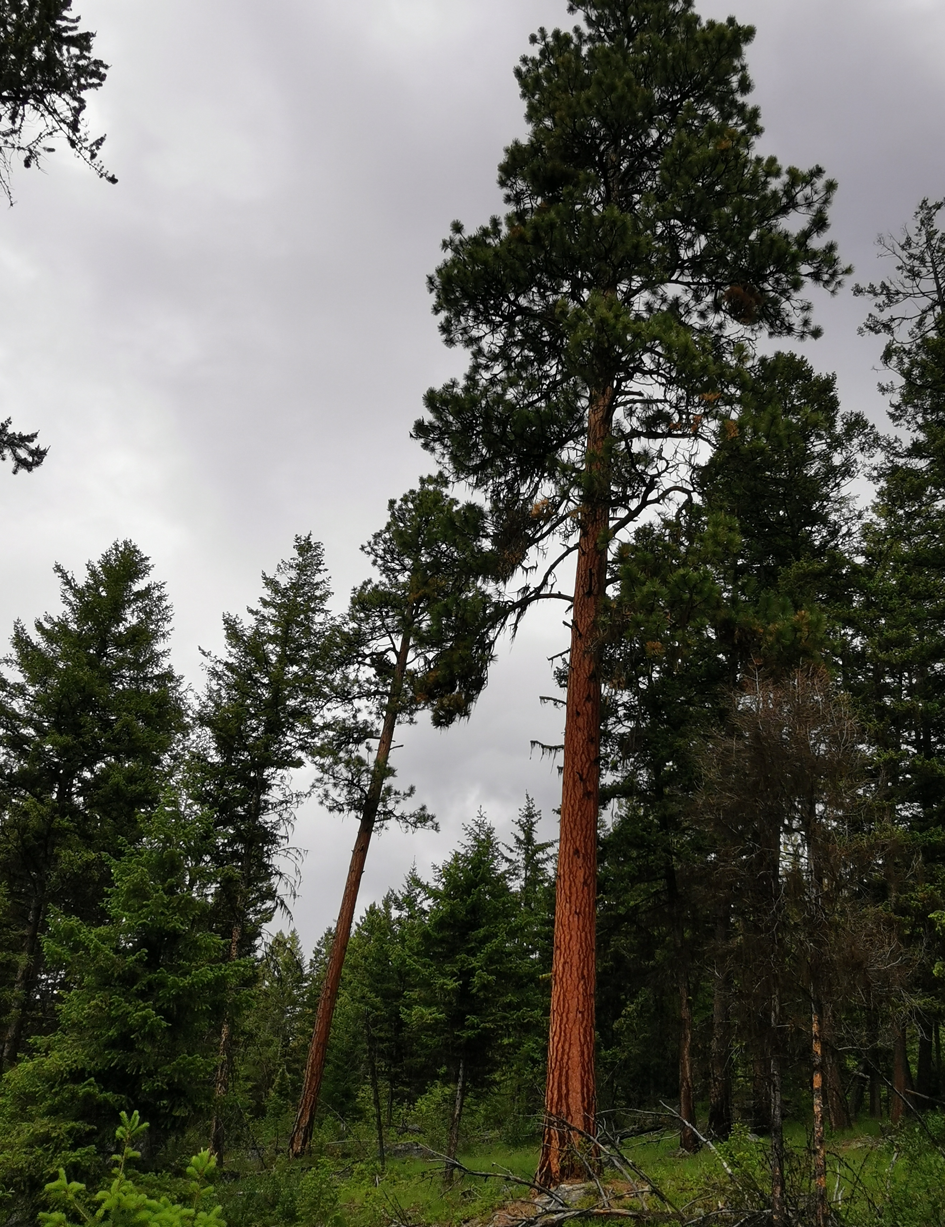
Looking Forward
Project provides opportunities for:
  protecting lives and infrastructure by creating a defensible zone for wildfire crews
  Restores the forest to more natural state which mimics frequent stand maintaining wildfires
  Increases the browse availability to ungulates
  Developing awareness and understanding within the community of how to live in synergy within fire maintained Okanagan Valley ecosystems
Veteran Ponderosa, Ian P.

Slide 24
Questions?
z
Heavily Burned area, Ian P.

